Slide 1

INDIAN BIKE MARKET ANALYSIS
Finding suitable bikes by comparing price and technical features
EDA & WEB SCRAPING PROJECT
APPAJI SREE DHARMA SHASTA RAO
CSE AIML(BTech)
Tools: Python, Requests, BeautifulSoup, Pandas, Matplotlib and Seaborn
LinkedIn: https://www.linkedin.com/in/appaji-sree-dharma-shasta-rao-33133129b/

Slide 2

Agenda
01 Project Foundation
02 Exploratory Analysis
03 Findings
Problem statement & objective
Why BikeWale
Dataset and feature meanings
• Scraping workflow
• Cleaning and missing values
• Outlier detection
• Univariate and bivariate EDA
• Correlation and pivot table
• Insights, limitations and conclusion

Slide 3
Introduction
Problem Statement
Purpose of the Analysis
Choosing the best bike in India can be difficult because different models offer different prices, mileage, engine capacities, power outputs, weights and user ratings. Comparing these features manually across multiple product pages is time-consuming.
Collect bike specifications from BikeWale using web scraping.
Organise the collected information into a structured dataset.
Explore important bike features using EDA.
Compare bikes based on affordability, mileage, performance and user ratings.
Identify suitable options for different buyer requirements.
Project Objective
To analyse and identify the best bikes in India based on their features.

Slide 4
Why This Project
65
22
11
54
Cleaned Records
Brands
Electric Records
Petrol/Other Records
Why this dataset
Why this source
Project Objective
The dataset combines market features such as price and user ratings with technical specifications such as engine capacity, power, mileage and weight. These features help compare bikes based on different buyer requirements.
BikeWale provides individual bike product pages containing useful specifications. It offers a practical source for collecting and analysing comparable bike information using web scraping.
To analyse and identify the best bikes in India based on their features by comparing affordability, mileage, engine capacity, power, weight and user ratings.

Slide 5
Dataset Information
Source
Data Collection Tools
Sample
Data Source: BikeWale
Website: https://www.bikewale.com/
Requests – to retrieve web-page HTML.
BeautifulSoup – to parse HTML content.
Regular Expressions – to extract relevant values from text.
Pandas – to store and analyse the collected data.
65 bike records in the cleaned dataset.
22 brands represented.
Includes electric and petrol/other bikes.
Individual bike specifications analysed.
Raw Dataset Columns
Bike Name
URL
Starting Price
Engine Capacity (CC)
Mileage (KMPL)
Max Power (BHP)
Kerb Weight (KG)
User Rating
Number of Ratings
The scraped values were inspected and cleaned before EDA.

Slide 6
Understanding Dataset
Feature Meaning
Initial Observations
Bike Name: Identifies the bike model.
URL: Provides the source page for the record.
Brand: Identifies the manufacturer.
Starting Price: Listed starting price in Indian rupees.
Engine Capacity: Engine displacement measured in cc.
Mileage: Reported fuel economy, generally in km/l.
Maximum Power: Reported engine power.
Kerb Weight: Weight of the bike in kilograms.
User Rating: Rating given by users.
Number of Ratings: Number of user ratings, when available.
Specifications were collected from BikeWale webpages.
Price and technical specifications required cleaning and numeric conversion.
Some specifications were missing or unavailable.
Electric and petrol bikes required separate consideration.
Suspicious model names and specifications were flagged for verification before final analysis.

Slide 7
Data Cleaning
Names
Missing Values
Duplicates
Outliers
Raw dataset collected from BikeWale.
65 records in the cleaned dataset.
22 brands represented.
Bike names and source URLs retained for verification.
Suspicious model names flagged for review.
Starting Price: No missing values.
Engine Capacity: 14 missing values.
Mileage: 22 missing values.
Maximum Power: 10 missing values.
Kerb Weight: 22 missing values.
Missing specifications were not automatically replaced with zero.
Duplicate rows: 0.
Duplicate records were checked in the cleaned dataset.
Source URLs were retained to support record verification.
Method: Interquartile Range (IQR).
Price outliers were examined separately.
High prices may represent premium bikes rather than errors.
Suspicious specifications require source verification before final analysis.
Sample Composition
Final Verification
Cleaned dataset: 65 rows × 14 columns.
Missing specifications retained where unavailable.
Suspected extraction errors flagged for review.
Dataset prepared for exploratory data analysis (EDA).
Brand Distribution
22 brands represented.
65 bike records in total.
Includes electric and petrol/other bikes.
Brand counts describe this scraped sample, not the entire Indian market

Slide 8
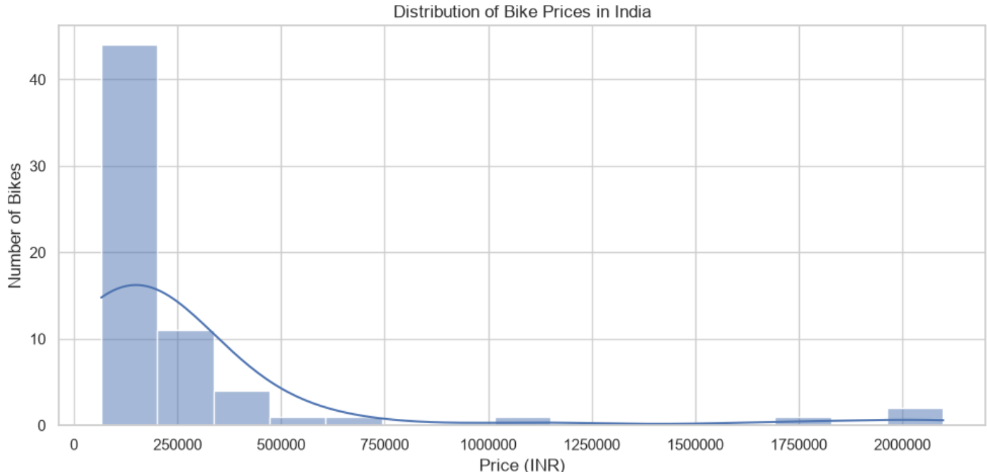
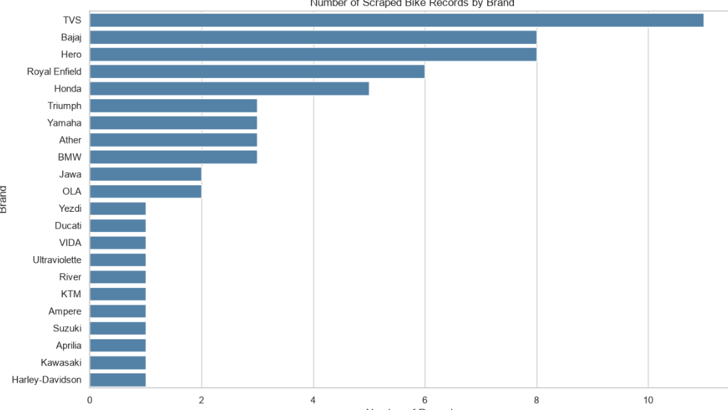
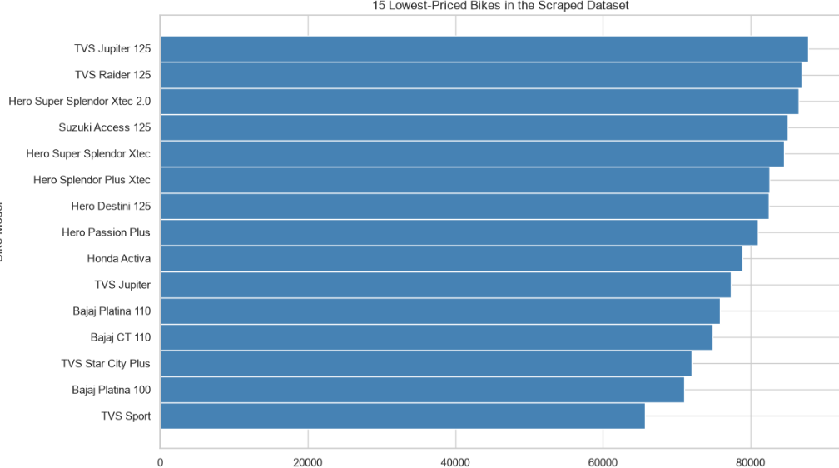
Univariate Analysis
Price distribution
15 Lowest-Priced Bikes
Bike Records by Brand
Key observation
Bike prices are right-skewed, with a small number of high-priced models.
The lowest-priced models highlight budget-friendly options in the sample.
TVS has the highest representation, with 11 records.
Brand counts represent the scraped sample, not the entire Indian motorcycle market.

Slide 9
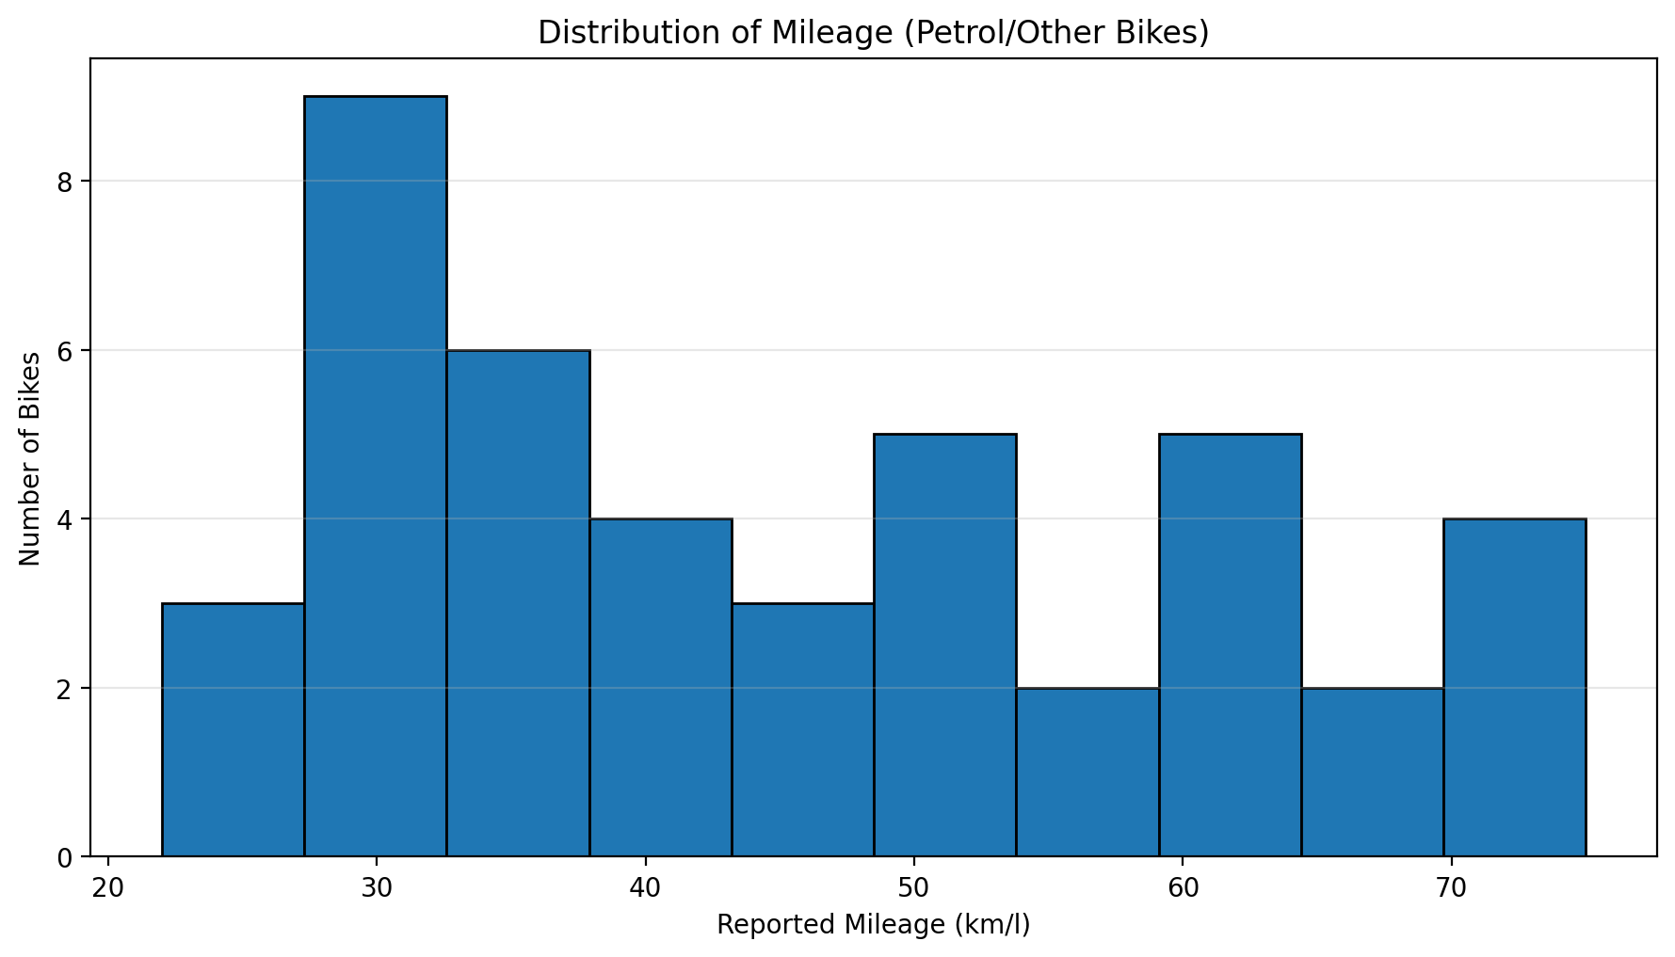
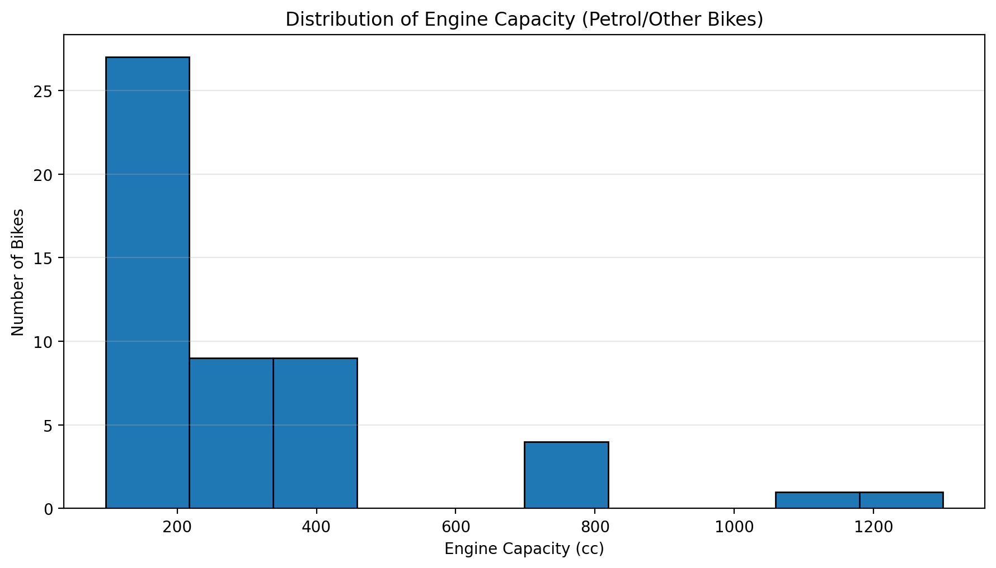
Univariate Analysis
Distribution of Mileage & Engine Capacity
Key observation
Mileage varies across the sampled petrol/other bikes, with recorded values ranging from 22 to 75 km/l.
Engine capacity ranges from 97.2 cc to 1,300 cc in the available records.
The distributions show variation between smaller commuter bikes and higher-capacity motorcycles.
Electric bikes were excluded because engine capacity and petrol mileage are not directly applicable.
Missing values were excluded from the respective histograms.

Slide 10
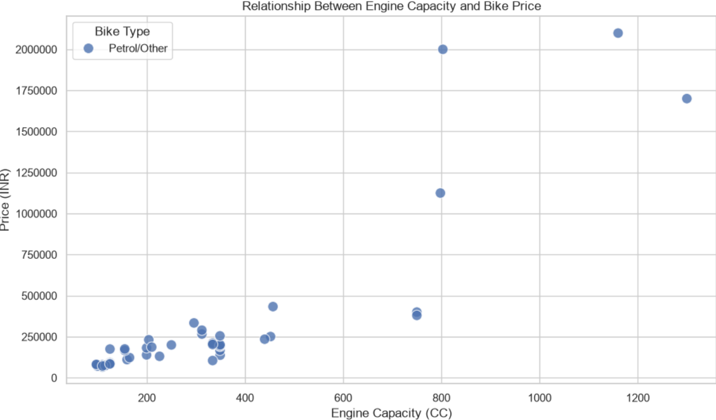
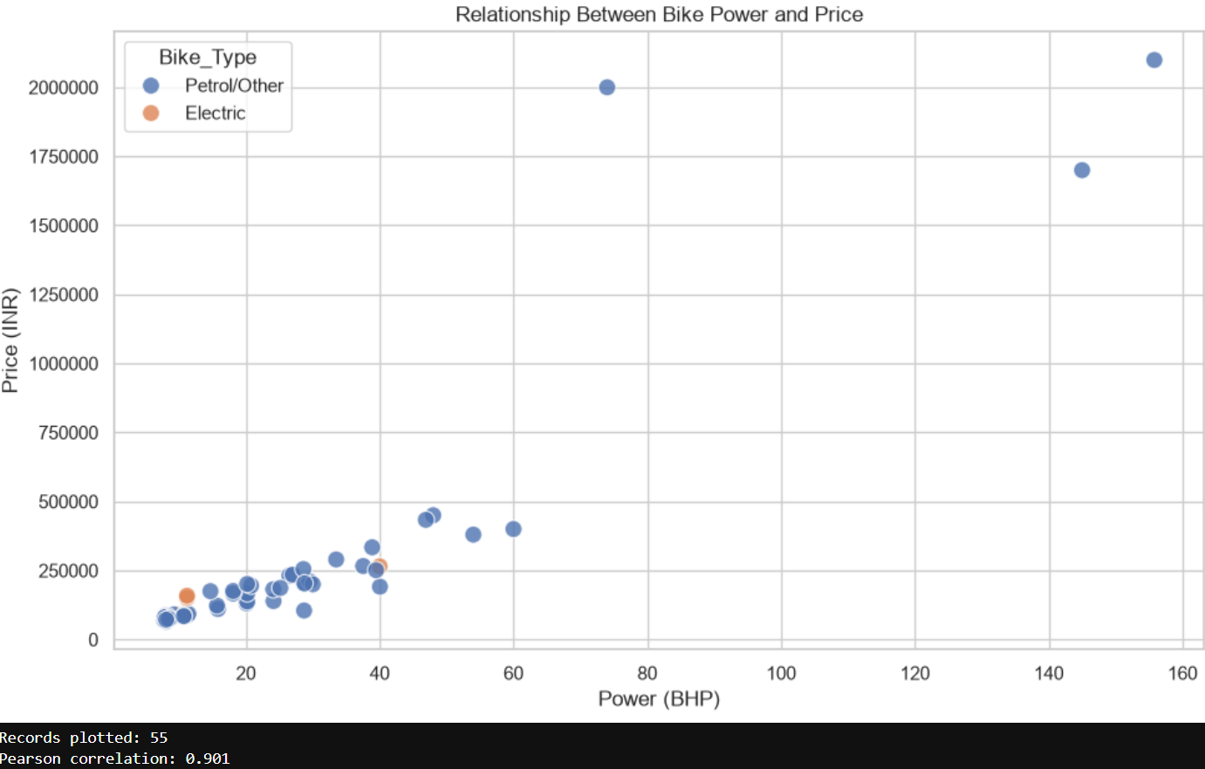
Bivariate Analysis: Price vs Performance
Engine capacity vs price
Power vs Price
Key Insights
Bike prices generally increase with engine capacity and power.
Higher-performance bikes tend to occupy higher price ranges in this sample.
A few premium models create extreme values and influence the relationships.
The observed trends should be interpreted cautiously because some specifications require verification.

Slide 11
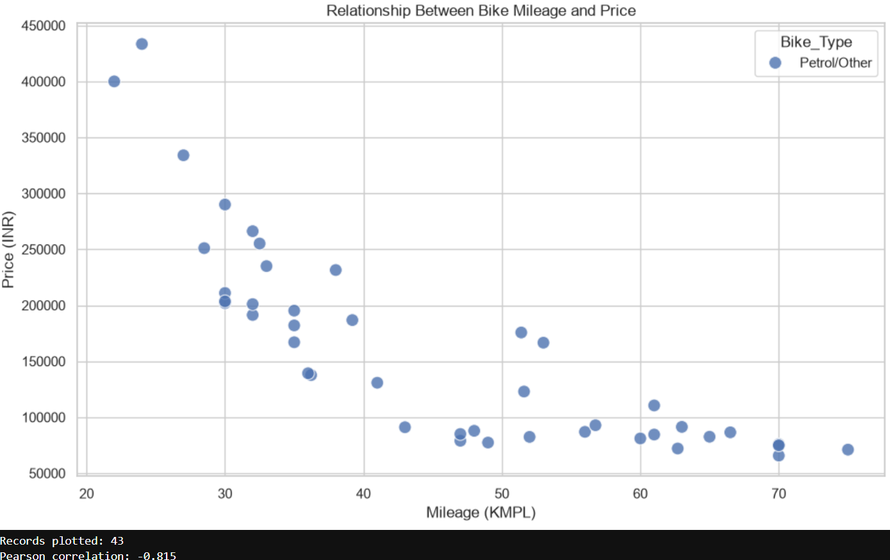
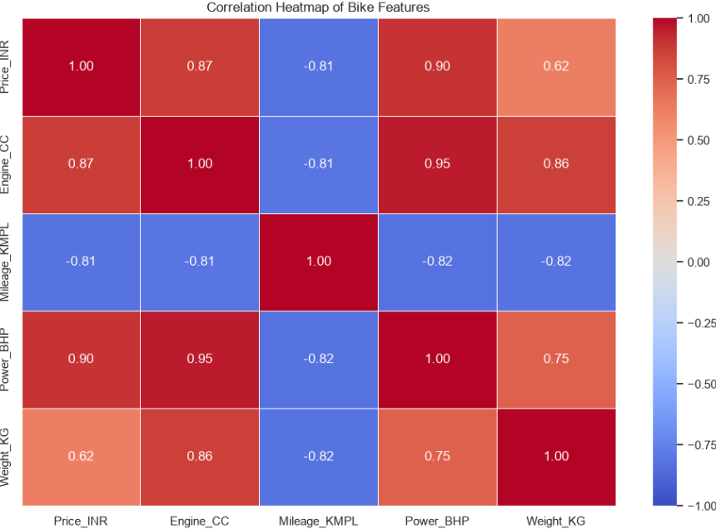
Bivariate Analysis: Mileage vs Price
Multivariate Analysis: Correlation Heatmap
Key Insights
Mileage and price show a strong negative correlation (r = −0.815) in the available sample.
Price has strong positive correlations with engine capacity (r = 0.87) and power (r = 0.90).
Engine capacity and power are strongly correlated (r = 0.95).
These relationships are associations in the scraped sample and do not imply causation.

Slide 12
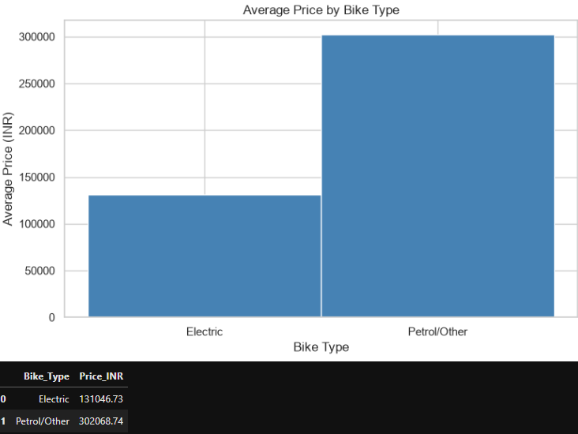
Insights (Visual and Non-Visual)
Average price by type
Electric
₹1,31,047
Petrol / Other
₹3,02,069
The petrol/other mean is affected by high-priced premium models; medians differ less: Electric ₹1,19,444; Petrol/Other ₹1,75,346.
Visual insight
Non-visual insight
Why pivot tables help
Higher engine capacity and power are generally associated with higher prices in the collected sample.
TVS has 11 records in the cleaned dataset, followed by Bajaj and Hero with 8 records each. These counts describe the collected sample, not the overall Indian market.
Pivot tables summarize data by bike type, brand, or price segment, making group-level comparisons easier and supporting data-driven decisions.

Slide 13
Insights (Visual and Non-Visual)
        Most records in the scraped sample fall within lower price ranges, while a few premium models extend the price distribution.
        Engine capacity and power show positive relationships with price in the available sample.
        Mileage and price show a negative relationship in the available records.
        TVS has the highest representation in the cleaned dataset, with 11 records.
        Electric and petrol bikes require different comparison criteria because their powertrain specifications differ.
        These findings describe the scraped sample and should not be interpreted as a complete picture of the Indian two-wheeler market.
BEST FOR DAILY COMMUTE
Feature: Higher reported mileage and affordable starting price
Select the bike with the highest verified mileage among suitable, budget-friendly petrol bikes.
BEST FOR HIGH PERFORMANCE
Feature: Maximum engine power
Select the bike with the highest verified power output among the available records.
BEST FOR VALUE
Feature: Balance of price, user rating, and practical specifications
Compare verified prices, user ratings, and available specifications before selecting a model.
Category Leaders at a Glance
Budget Bike: Lowest verified starting price in the sample.
Mileage Leader: Highest verified reported mileage among petrol bikes.
Electric Option: Compare starting price, battery capacity, and claimed range where available.

Slide 14
Conclusion
This project demonstrates an end-to-end workflow for collecting bike specifications from BikeWale, cleaning the scraped data, and performing univariate, bivariate, and multivariate Exploratory Data Analysis (EDA). The cleaned dataset contains 65 bike records across 22 brands. The analysis reveals considerable variation in bike prices, with most records concentrated in lower price ranges and a few premium models extending the distribution. Price shows positive associations with engine capacity and power, while mileage shows a negative association with price in the available sample. The analysis also highlights the importance of handling missing values, checking suspicious specifications, and comparing electric and petrol bikes using appropriate features. Overall, the project provides a data-driven approach to comparing bikes according to buyer priorities, while the findings remain limited to the collected sample and require further source verification.

Slide 15

THANK YOU

